Slide 1
Predicting Customer Churn in Telecom Industry using Power BI and SQL

Slide 2
Project overview
This project aims to predict customer churn in the telecom industry by leveraging SQL for data extraction and Power BI for data visualization. By analyzing customer behavior and service usage patterns, we can identify factors contributing to churn and develop strategies to improve customer retention.
Tools used
My SQL
Power BI
Problem Statement:
Predicting Customer Churn in Telecom Industry

Slide 3
SQL queries
Identify the total number of customers and the churn rate
Find the average age of churned customers
Analyze the distribution of monthly charges among churned customers
Create a query to identify the contract types that are most prone to churn
Identify customers with high total charges who have churned
Calculate the total charges distribution for churned and non-churned customers
Identify customers who have both online security and online backup services and have not churned
Determine the most common combinations of services among churned customers

Slide 4
Calculate the average monthly charges for different age groups among churned customers
Determine the average age and total charges for customers with multiple lines and online backup
Calculate the average monthly charges for customers who have multiple lines and streaming TV
Identify the customers who have churned and used the most online services
Calculate the average age and total charges for customers with different combinations of streaming services
Calculate the average monthly charges and total charges for customers who have churned, grouped by contract type and internet service type
Find the customers who have churned and are not using online services, and their average total charges
Calculate the average monthly charges and total charges for customers who have churned, grouped by the number of dependents

Slide 5
Identify the customers who have churned, and their contract duration in months (for monthly contracts)
Determine the average age and total charges for customers who have churned, grouped by internet service and phone service
Create a view to find the customers with the highest monthly charges in each contract type
Create a view to find the customers who have churned and their cumulative total charges over time
Create a stored procedure to calculate churn rate
Create a stored procedure to find high-value customers at risk of churning

Slide 6


1.Identify the total number of customers and the churn rate
select
(select COUNT(*) from customer_churn) as total_customers,
COUNT(*) as total_churned_customers,
(COUNT(*) * 100.0) / (select COUNT(*) from customer_churn) as churn_rate_percentage
from customer_churn
where customer_status = 'Churned';
2.Find the average age of churned customers
select avg(age) as average_age_churned_customers from customer_churn
where customer_status = 'churned';

Slide 7


3.Analyze the distribution of monthly charges among churned customers
select avg(monthly_charge) as avg_monthly_charge
from customer_churn
where customer_status = 'churned';
4.Create a query to identify the contract types that are most prone to churn
select contract,
count(*) as total_customers,
sum(case when customer_status = 'churned' then 1 else 0 end) as churned_customers,
(sum(case when customer_status = 'churned' then 1 else 0 end) * 1.0 / count(*)) as churn_rate
from customer_churn
group by contract
order by churn_rate desc;

Slide 8
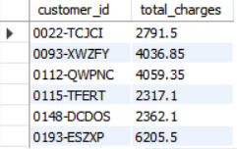
5.Identify customers with high total charges who have churned
select customer_id, total_charges
from customer_churn
where customer_status = 'churned' and total_charges > (select avg(total_charges) from customer_churn);

Slide 9

6.Calculate the total charges distribution for churned and non-churned customers
select customer_status as churn_status,count(*) as customer_count,
sum(total_charges) as total_charges,
avg(total_charges) as avg_total_charges
from customer_churn
group by customer_status;

Slide 10
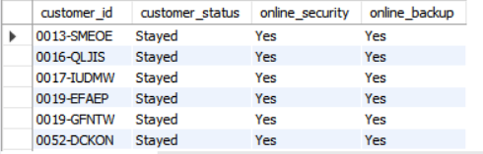
7. Identify customers who have both online security and online backup services and have not churned
select customer_id, customer_status, online_security, online_backup
from customer_churn
where online_security = 'yes' and online_backup = 'yes' and customer_status = 'stayed';

Slide 11
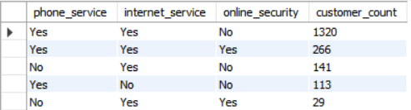
8.Determine the most common combinations of services among churned customers
select phone_service, internet_service, online_security, count(*) as customer_count
from customer_churn
where customer_status = 'churned'
group by phone_service, internet_service, online_security
order by customer_count desc;

Slide 12
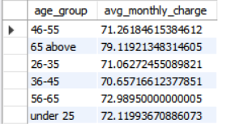
9.Calculate the average monthly charges for different age groups among churned customers
select
case
when age < 25 then 'under 25'
when age between 25 and 35 then '26-35'
when age between 36 and 45 then '36-45'
when age between 46 and 55 then '46-55'
when age between 56 and 65 then '56-65'
else '65 above'
end as age_group,
avg(monthly_charge) as avg_monthly_charge
from customer_churn
where customer_status = 'churned'
group by age_group;

Slide 13

10.Determine the average age and total charges for customers with multiple lines and online backup
select avg(age) as avg_age, avg(total_charges) as avg_total_charges
from customer_churn
where multiple_lines = 'yes' and online_backup = 'yes';

Slide 14
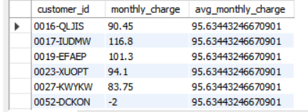
11.Calculate the average monthly charges for customers who have multiple lines and streaming TV
select customer_id, monthly_charge,
(select avg(monthly_charge)
from customer_churn
where multiple_lines = 'yes' and streaming_tv = 'yes') as avg_monthly_charge
from customer_churn
where multiple_lines = 'yes' and streaming_tv = 'yes';

Slide 15
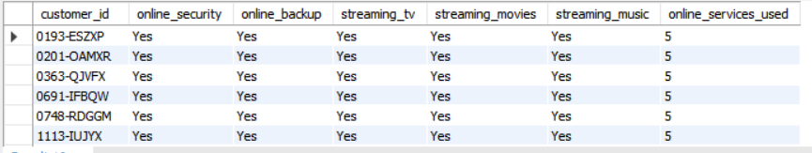
12.Identify the customers who have churned and used the most online services
select customer_id, online_security, online_backup, streaming_tv, streaming_movies, streaming_music,
(
(case when online_security = 'yes' then 1 else 0 end) +
(case when online_backup = 'yes' then 1 else 0 end) +
(case when streaming_tv = 'yes' then 1 else 0 end) +
(case when streaming_movies = 'yes' then 1 else 0 end) +
(case when streaming_music = 'yes' then 1 else 0 end)
) as online_services_used
from customer_churn
where customer_status = 'churned'
order by online_services_used desc;

Slide 16
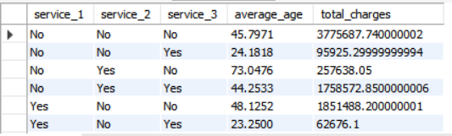
13.Calculate the average age and total charges for customers with different combinations of streaming services
with cte as (
select streaming_tv, streaming_movies, streaming_music,
avg(age) as average_age, sum(total_charges) as total_charges
from customer_churn
group by streaming_tv, streaming_movies, streaming_music
)
select streaming_tv as service_1, streaming_movies as service_2, streaming_music as service_3, average_age, total_charges
from cte
order by service_1, service_2, service_3;

Slide 17
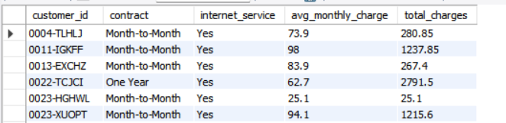
14.Calculate the average monthly charges and total charges for customers who have churned, grouped by contract type and internet service type
with cte as (
select customer_id, contract, internet_service,
avg(monthly_charge) as avg_monthly_charge,
sum(total_charges) as total_charges
from customer_churn
where customer_status = 'churned'
group by customer_id, contract, internet_service
)
select customer_id, contract, internet_service, avg_monthly_charge, total_charges
from cte
order by customer_id, contract, internet_service;

Slide 18
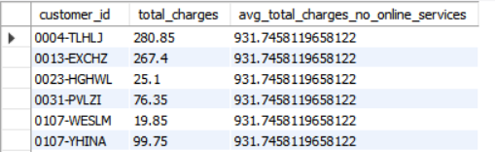
15.find the customers who have churned and are not using online services, and their average total charges
select customer_id, total_charges,
(select avg(total_charges)
from customer_churn
where customer_status = 'churned' and online_security = 'no' and online_backup = 'no') as avg_total_charges_no_online_services
from customer_churn
where customer_status = 'churned' and online_security = 'no' and online_backup = 'no';

Slide 19
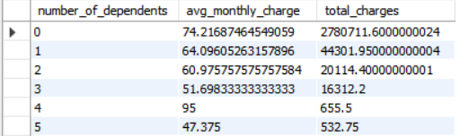
16.calculate the average monthly charges and total charges for customers who have churned, grouped by the number of dependents
select number_of_dependents, avg(monthly_charge) as avg_monthly_charge, sum(total_charges) as total_charges
from customer_churn
where customer_status = 'churned'
group by number_of_dependents
order by number_of_dependents;

Slide 20
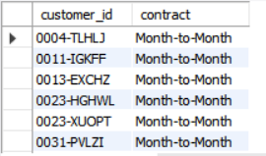
17.dentify the customers who have churned, and their contract duration in months (for monthly contracts)
select customer_id, contract
from customer_churn
where customer_status = 'churned' and contract = 'month-to-month';

Slide 21

18.Determine the average age and total charges for customers who have churned, grouped by internet service and phone service
select internet_service, phone_service, avg(age) as avg_age, sum(total_charges) as total_charges
from customer_churn
where customer_status = 'churned'
group by internet_service, phone_service
order by internet_service, phone_service;

Slide 22
19.create a view to find the customers with the highest monthly charges in each contract type
create view customers_highest_monthly_charges AS
select customer_id, contract, monthly_charge
from customer_churn
where monthly_charge = (
select MAX(monthly_charge)
from customer_churn as sub
where sub.contract = customer_churn.contract
);
select * from customers_highest_monthly_charges;

Slide 23
20.Create a view to find the customers who have churned and their cumulative total chargesover time
CREATE VIEW churned_customer_cumulative_charges AS
SELECT
c1.customer_id,
c1.tenure_in_months,
c1.total_charges,
(
SELECT SUM(c2.total_charges)
FROM customer_churn c2
WHERE c2.customer_id = c1.customer_id
AND c2.tenure_in_months <= c1.tenure_in_months
AND c2.customer_status = 'Churned'
) AS cumulative_total_charges
FROM customer_churn c1
WHERE c1.customer_status = 'Churned';
select * from churned_customer_cumulative_charges;

Slide 24
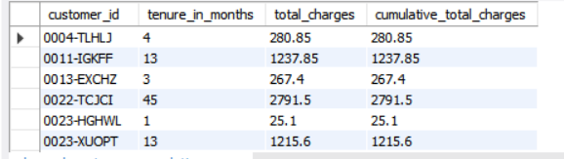

Slide 25

21.Stored procedure to calculate churn rate
delimiter //
create procedure calculate_churn_rate()
begin
declare total_customers int;
declare churned_customers int;
declare churn_rate decimal(5, 2);
select count(*) into total_customers from customer_churn;
select count(*) into churned_customers from customer_churn where customer_status = 'churned';
set churn_rate = (churned_customers / total_customers) * 100;
select churn_rate as churn_rate;
end //
delimiter ;
call calculate_churn_rate();

Slide 26
22.Create a stored procedure to find high-value customers at risk of churning
delimiter //
create procedure high_value_customers_at_risk()
begin
select
customer_id,
total_charges,
monthly_charge,
tenure_in_months,
case
when total_charges > 500 and tenure_in_months < 12 then 'At Risk'
else 'Not At Risk'
end as risk_status
from customer_churn
where total_charges > 500
order by total_charges desc;
end //
delimiter ;
call high_value_customers_at_risk();

Slide 27
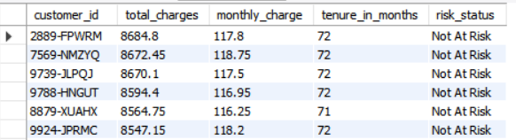
Power Bi
Discover the most common contract types among churned customers
Calculate the average monthly charges for different contract types among churned customers
Identify the average total charges for customers grouped by gender and marital status

Slide 28
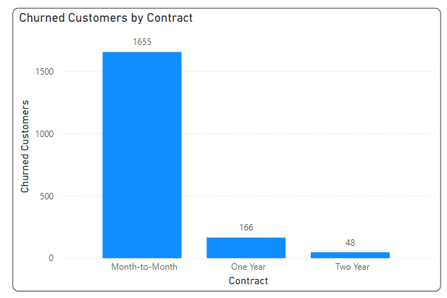
1.Discover the most common contract types among churned customers

Slide 29
2.Calculate the average monthly charges for different contract types among churned customers

Slide 30
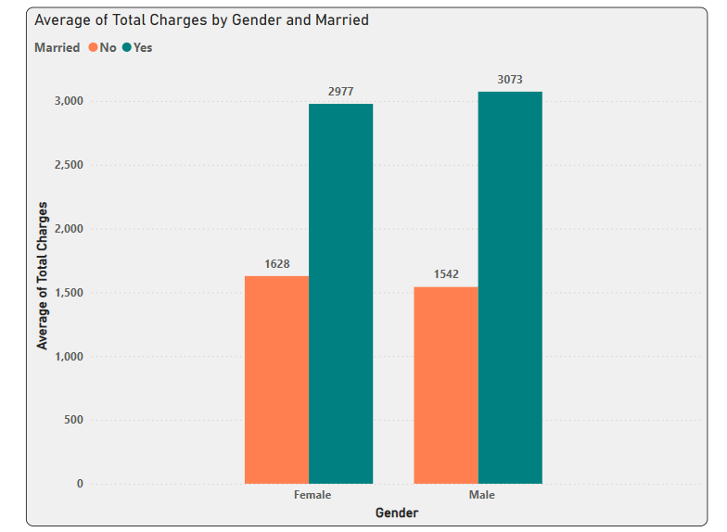
3.Identify the average total charges for customers grouped by gender and marital status

Slide 31
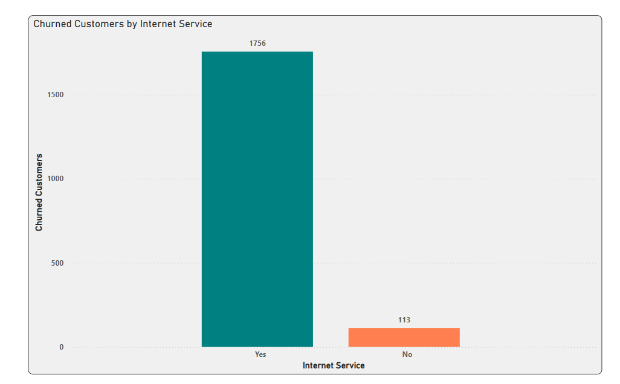
Visualization

Slide 32
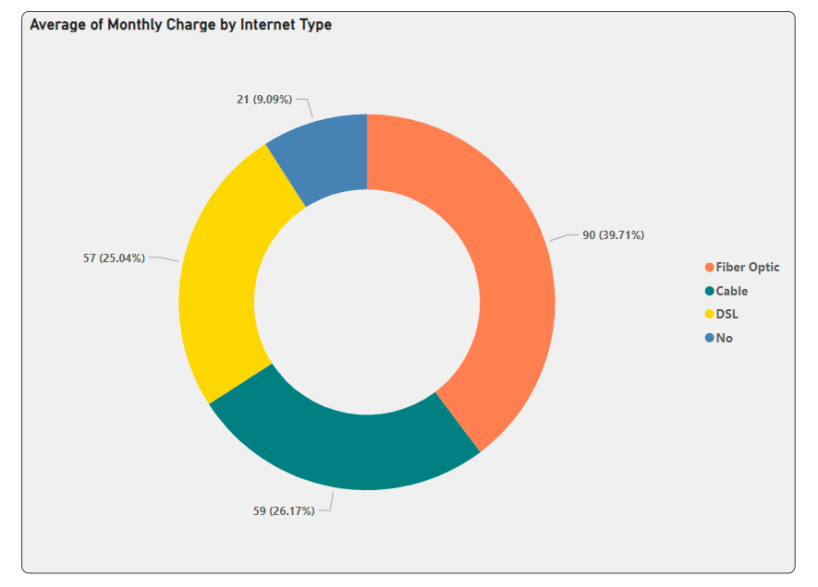

Slide 33
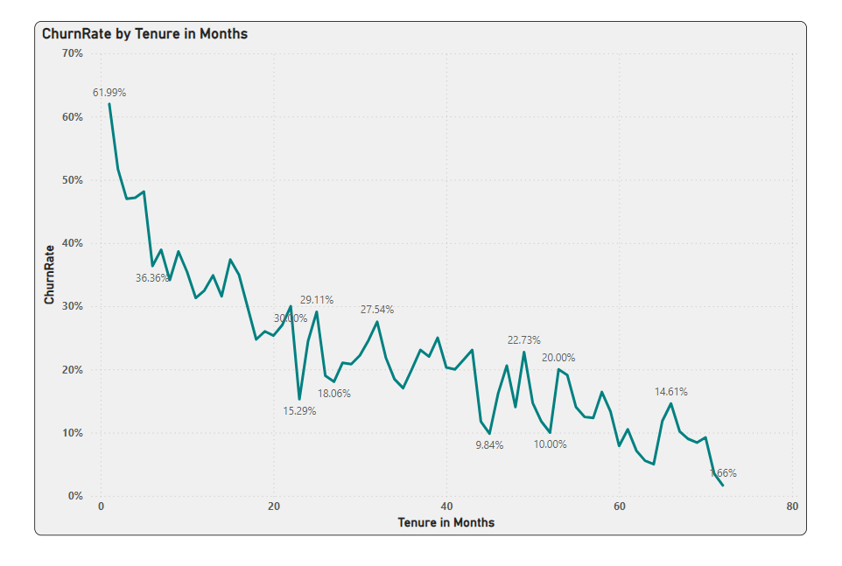

Slide 34
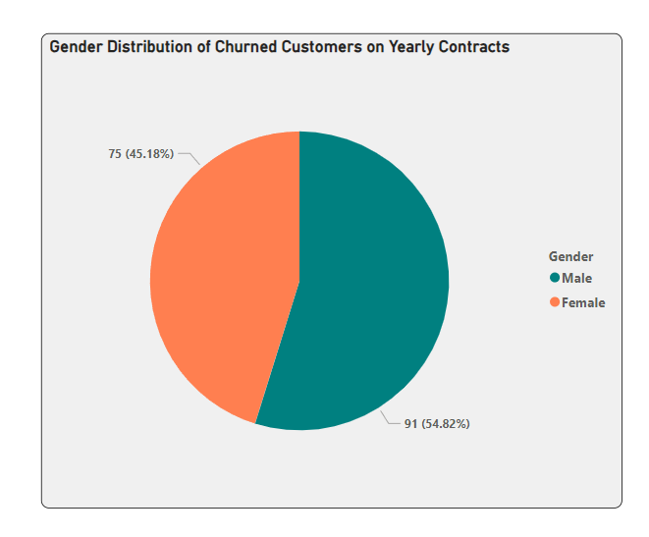

Slide 35
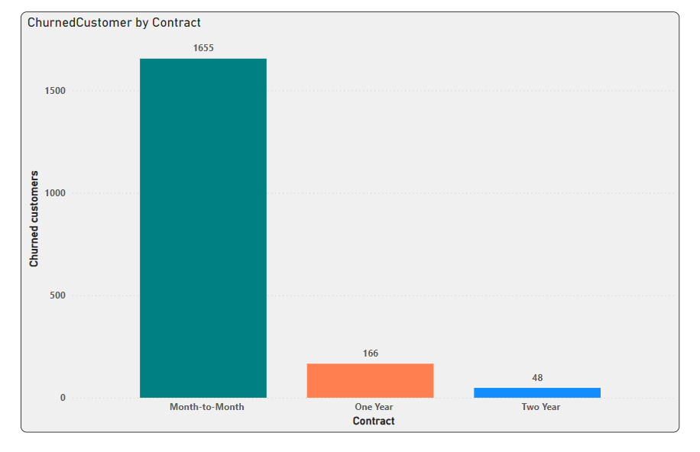

Slide 36
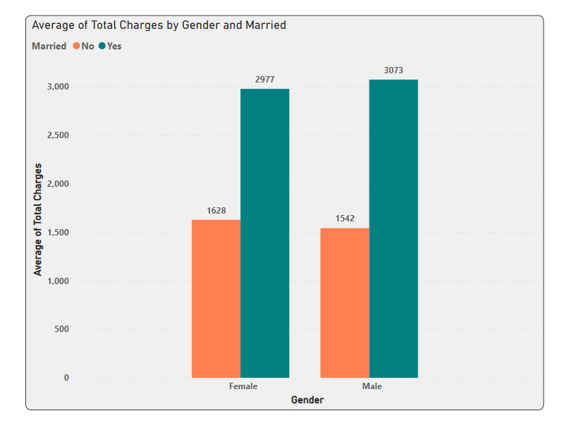

Slide 37
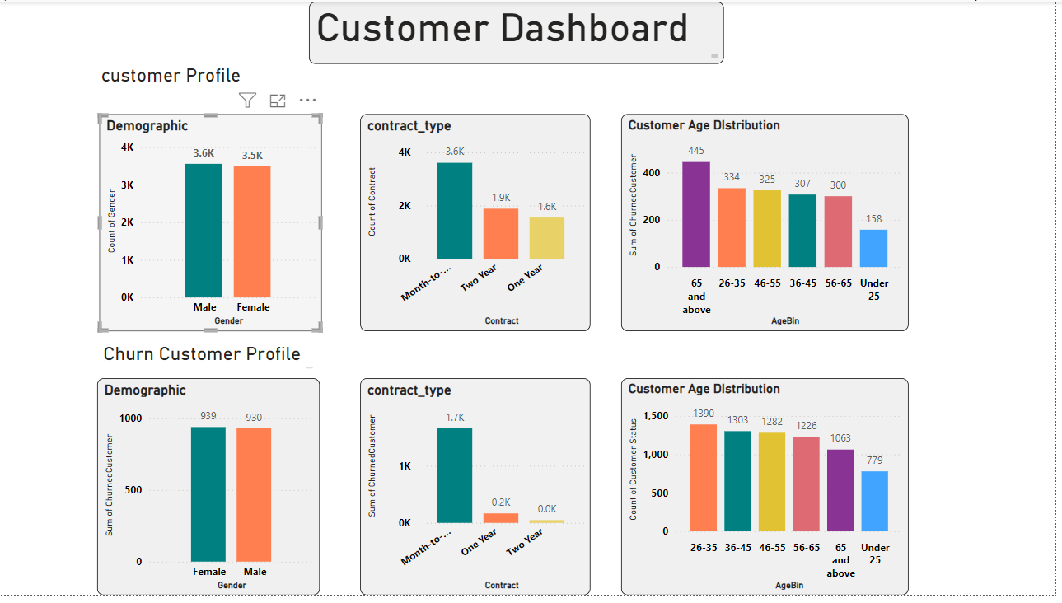

Slide 38
